Slide 1
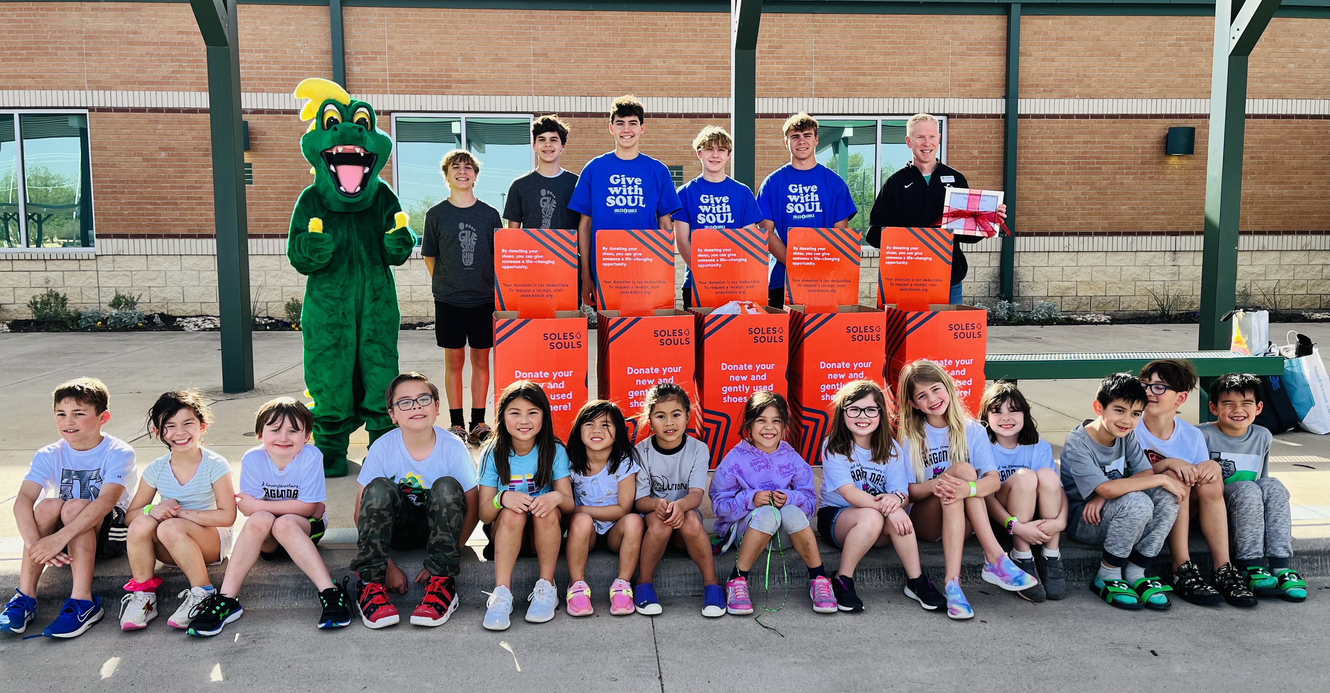

Slide 2
Our Mission
Soles4Souls helps people around the world who don’t have enough shoes and clothes. Since 2006, people have helped us get shoes and clothing to people in all over the United States and in 131 other countries.
Just last year, we…
Gave away 5,455,289 pairs of shoes to people in need. That many shoes would reach from the bottom of California to the top!
Gave away 3,104,281 pieces of clothing. That’s enough to fill the Big Ben tower three times!
Prevented 9,089,043 pairs of shoes and pieces of clothing from being thrown away. That stuff weighed as much as a thousand elephants!

Slide 3
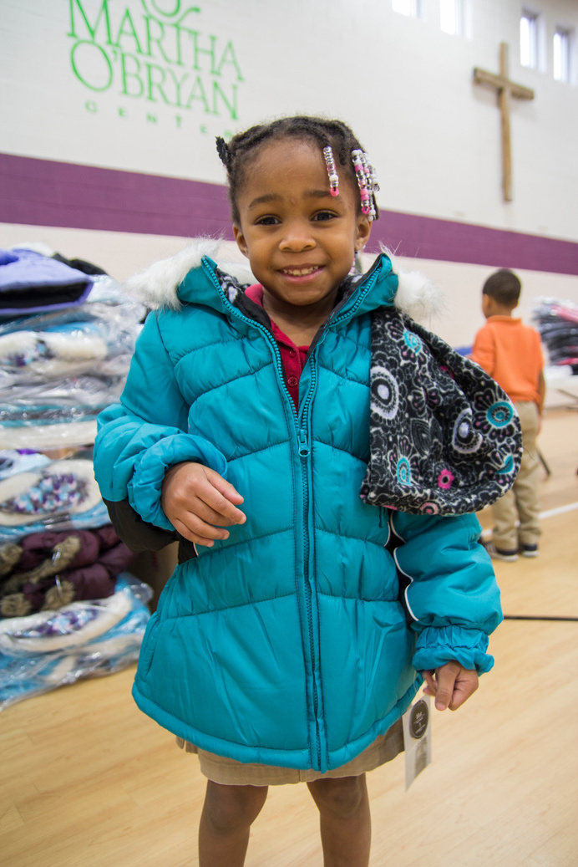
We give people shoes and clothes so they can have a better life.
Helping people have enough money for their family.
People can sell used shoes and clothes so they can buy food and have a place to live.
Helping people when they’re having a hard time.
Companies that make shoes and clothes give us some to share with people who don’t have any.

Slide 4
Working worldwide to provide opportunity.

Slide 5
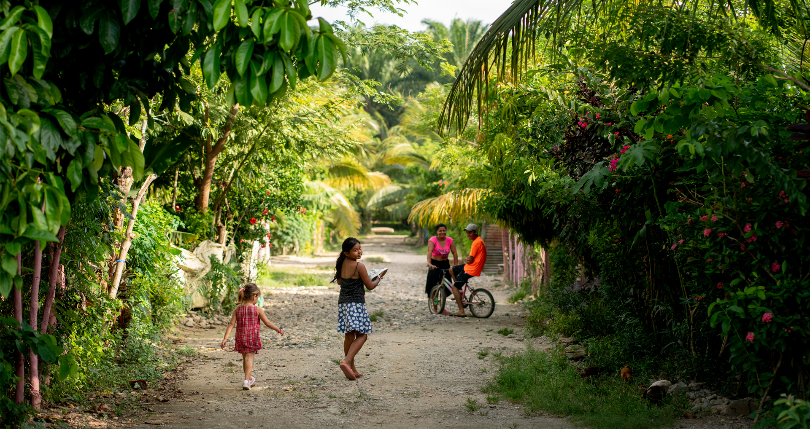
How we help

Slide 6
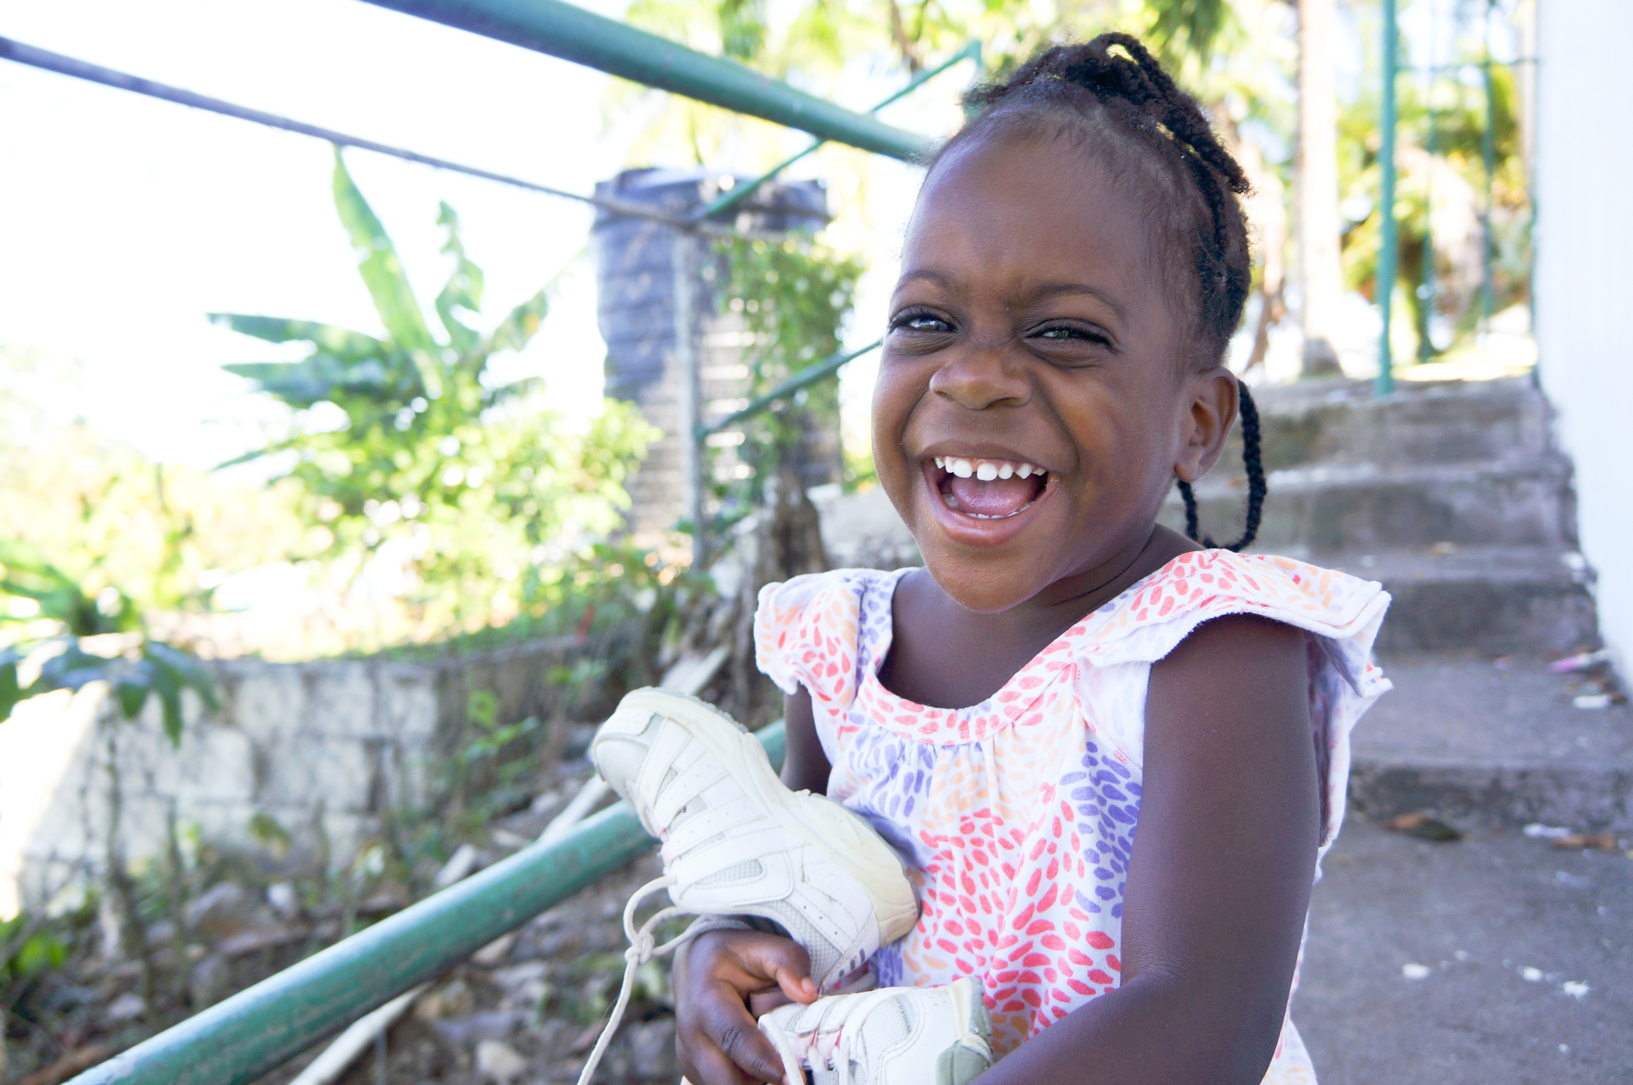
4Relief
When people don’t have enough money for everything they need, we give them shoes and clothes. That way they have one less thing to worry about.
We work with places like schools, homeless shelters, and hospitals to find people who could use some help.

Slide 7
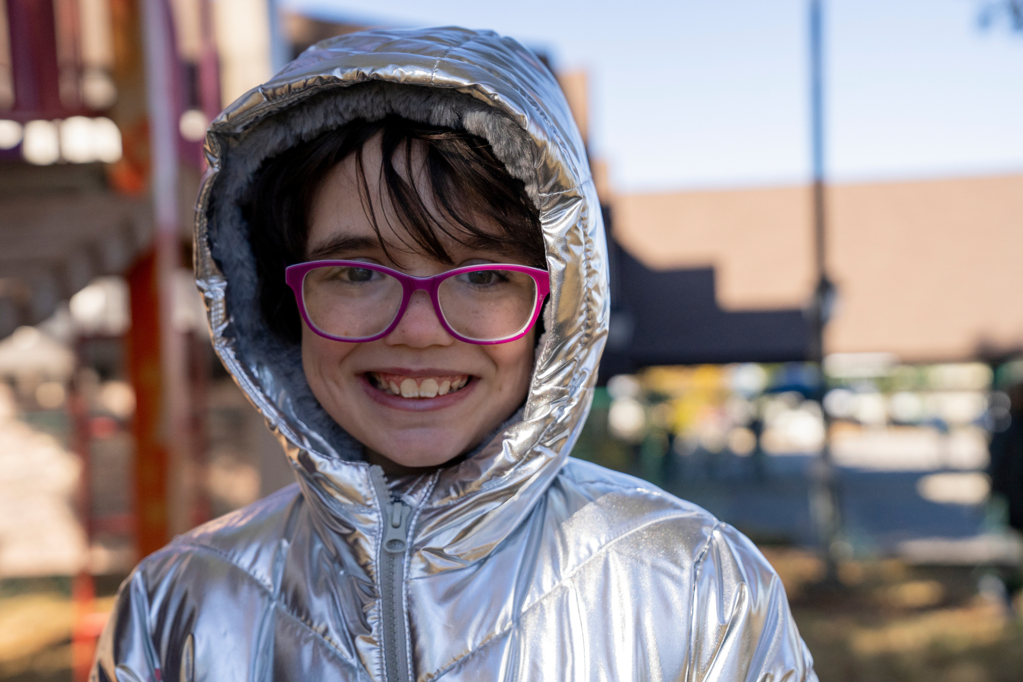
4Relief
How new shoes and clothes help people stay safe, healthy, and happy.
  We ask companies that make or sell shoes and clothes to donate their extras to us.
  Shelters, churches, and other caring people help us give the shoes and clothes to people who need them.
  People who receive the shoes and clothes feel better.

Slide 8
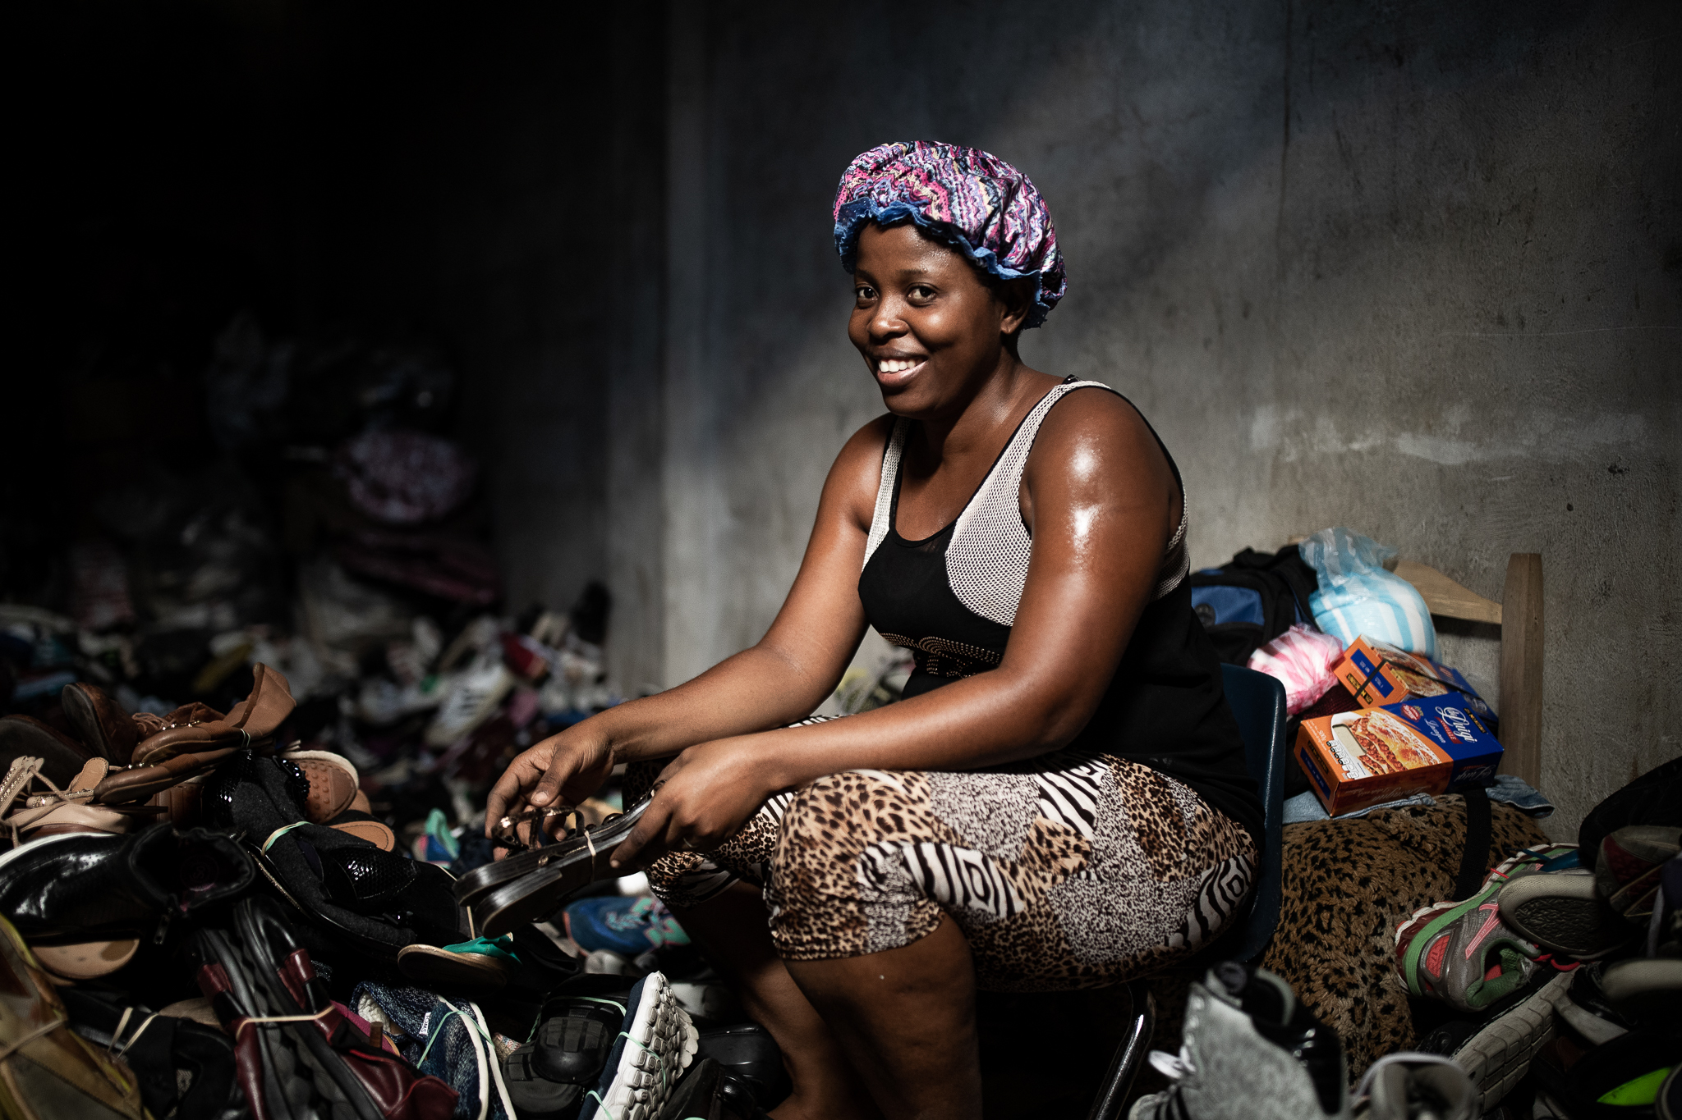
4Opportunity
In some other countries, there aren’t enough jobs, so grownups sometimes don’t have enough money for things like food.
We ask people to donate their shoes and clothes that don’t fit anymore. Then we help people in other countries sell them to make money—kind of like stores where you buy your shoes and clothes!

Slide 9
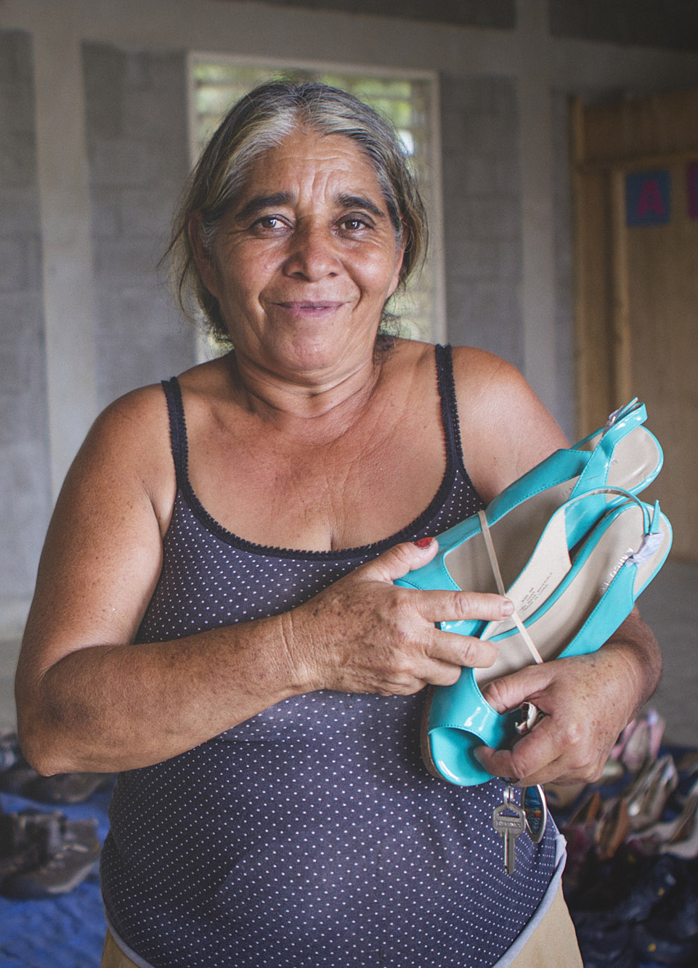
4Opportunity
How used shoes and clothes help people have enough money:
  We ask people to give us their used shoes and clothes.
  Our friends in other countries buy the shoes and clothes from us and then sell them for just a little bit of money to people who need help.
  The people who need help sell them to people in their town who need shoes and clothes.
  Now they have enough money to take care of their family!

Slide 10
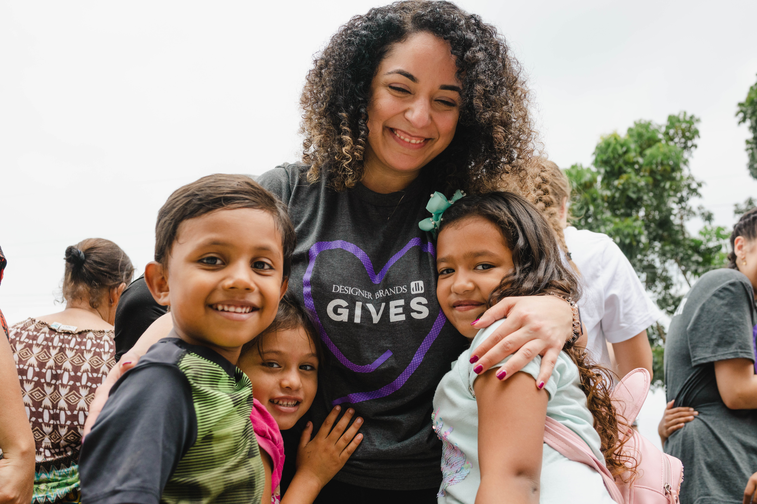
4EveryKid
Everything is really expensive right now in the United States, and it can be hard for grownups to buy everything their family needs. Some kids don’t even have a place to live.
We give them a new pair of tennis shoes so they can play with their friends, go to gym class, and feel just like the other kids.

Slide 11
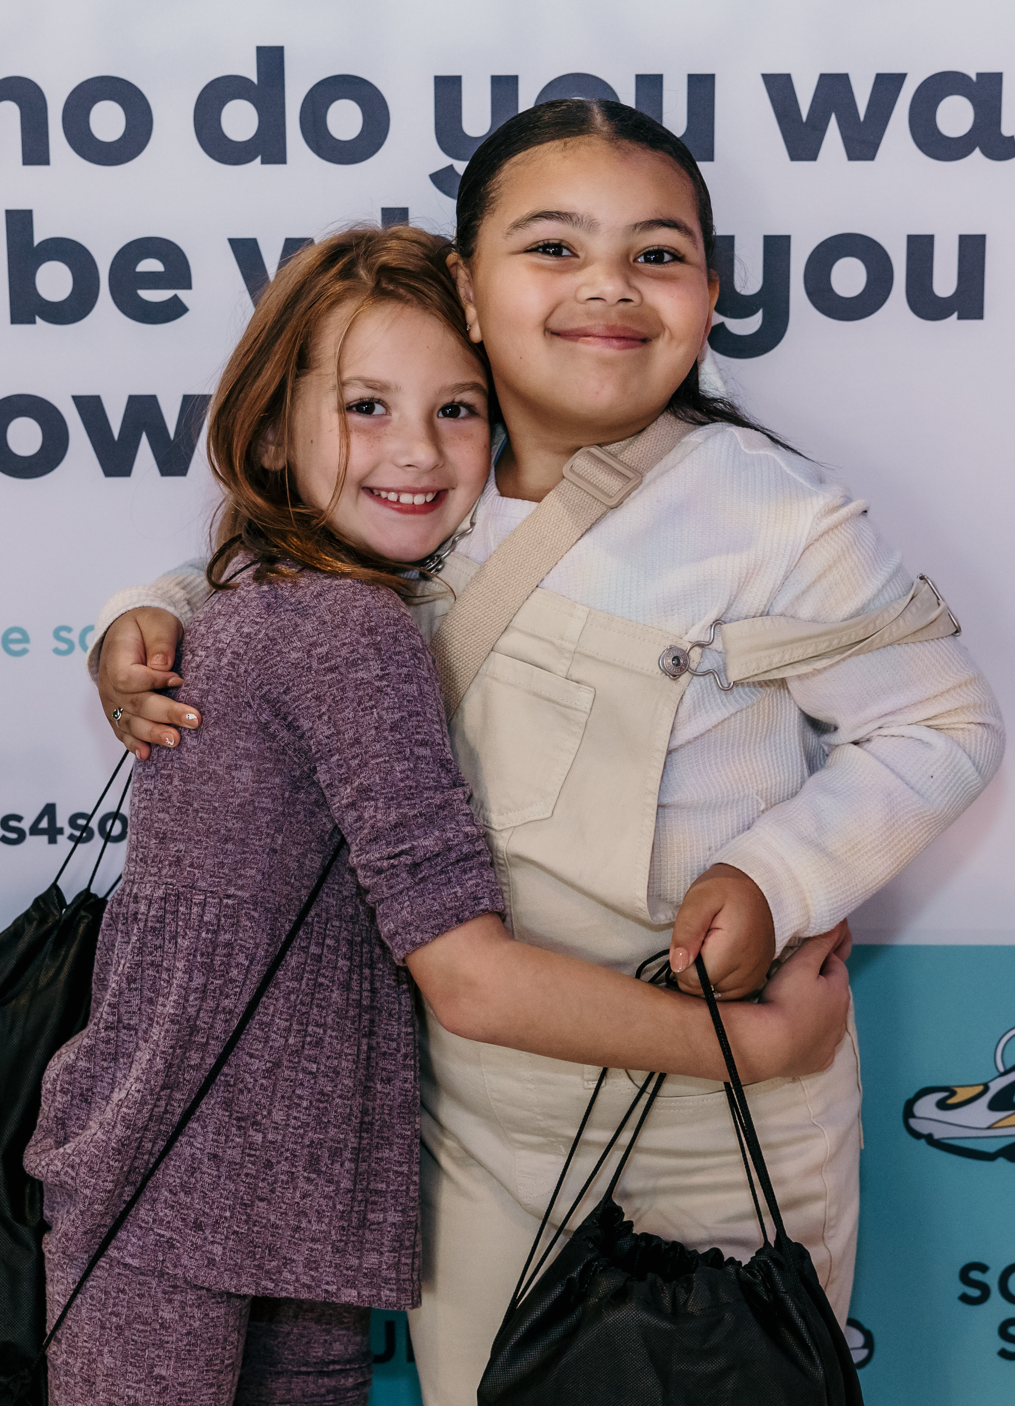
4EveryKid
New shoes are a big help to kids who don’t have a place to live.
They feel better about themselves.
They get to play more.
They go to school more often and get better grades.
They feel just like the other kids.

Slide 12
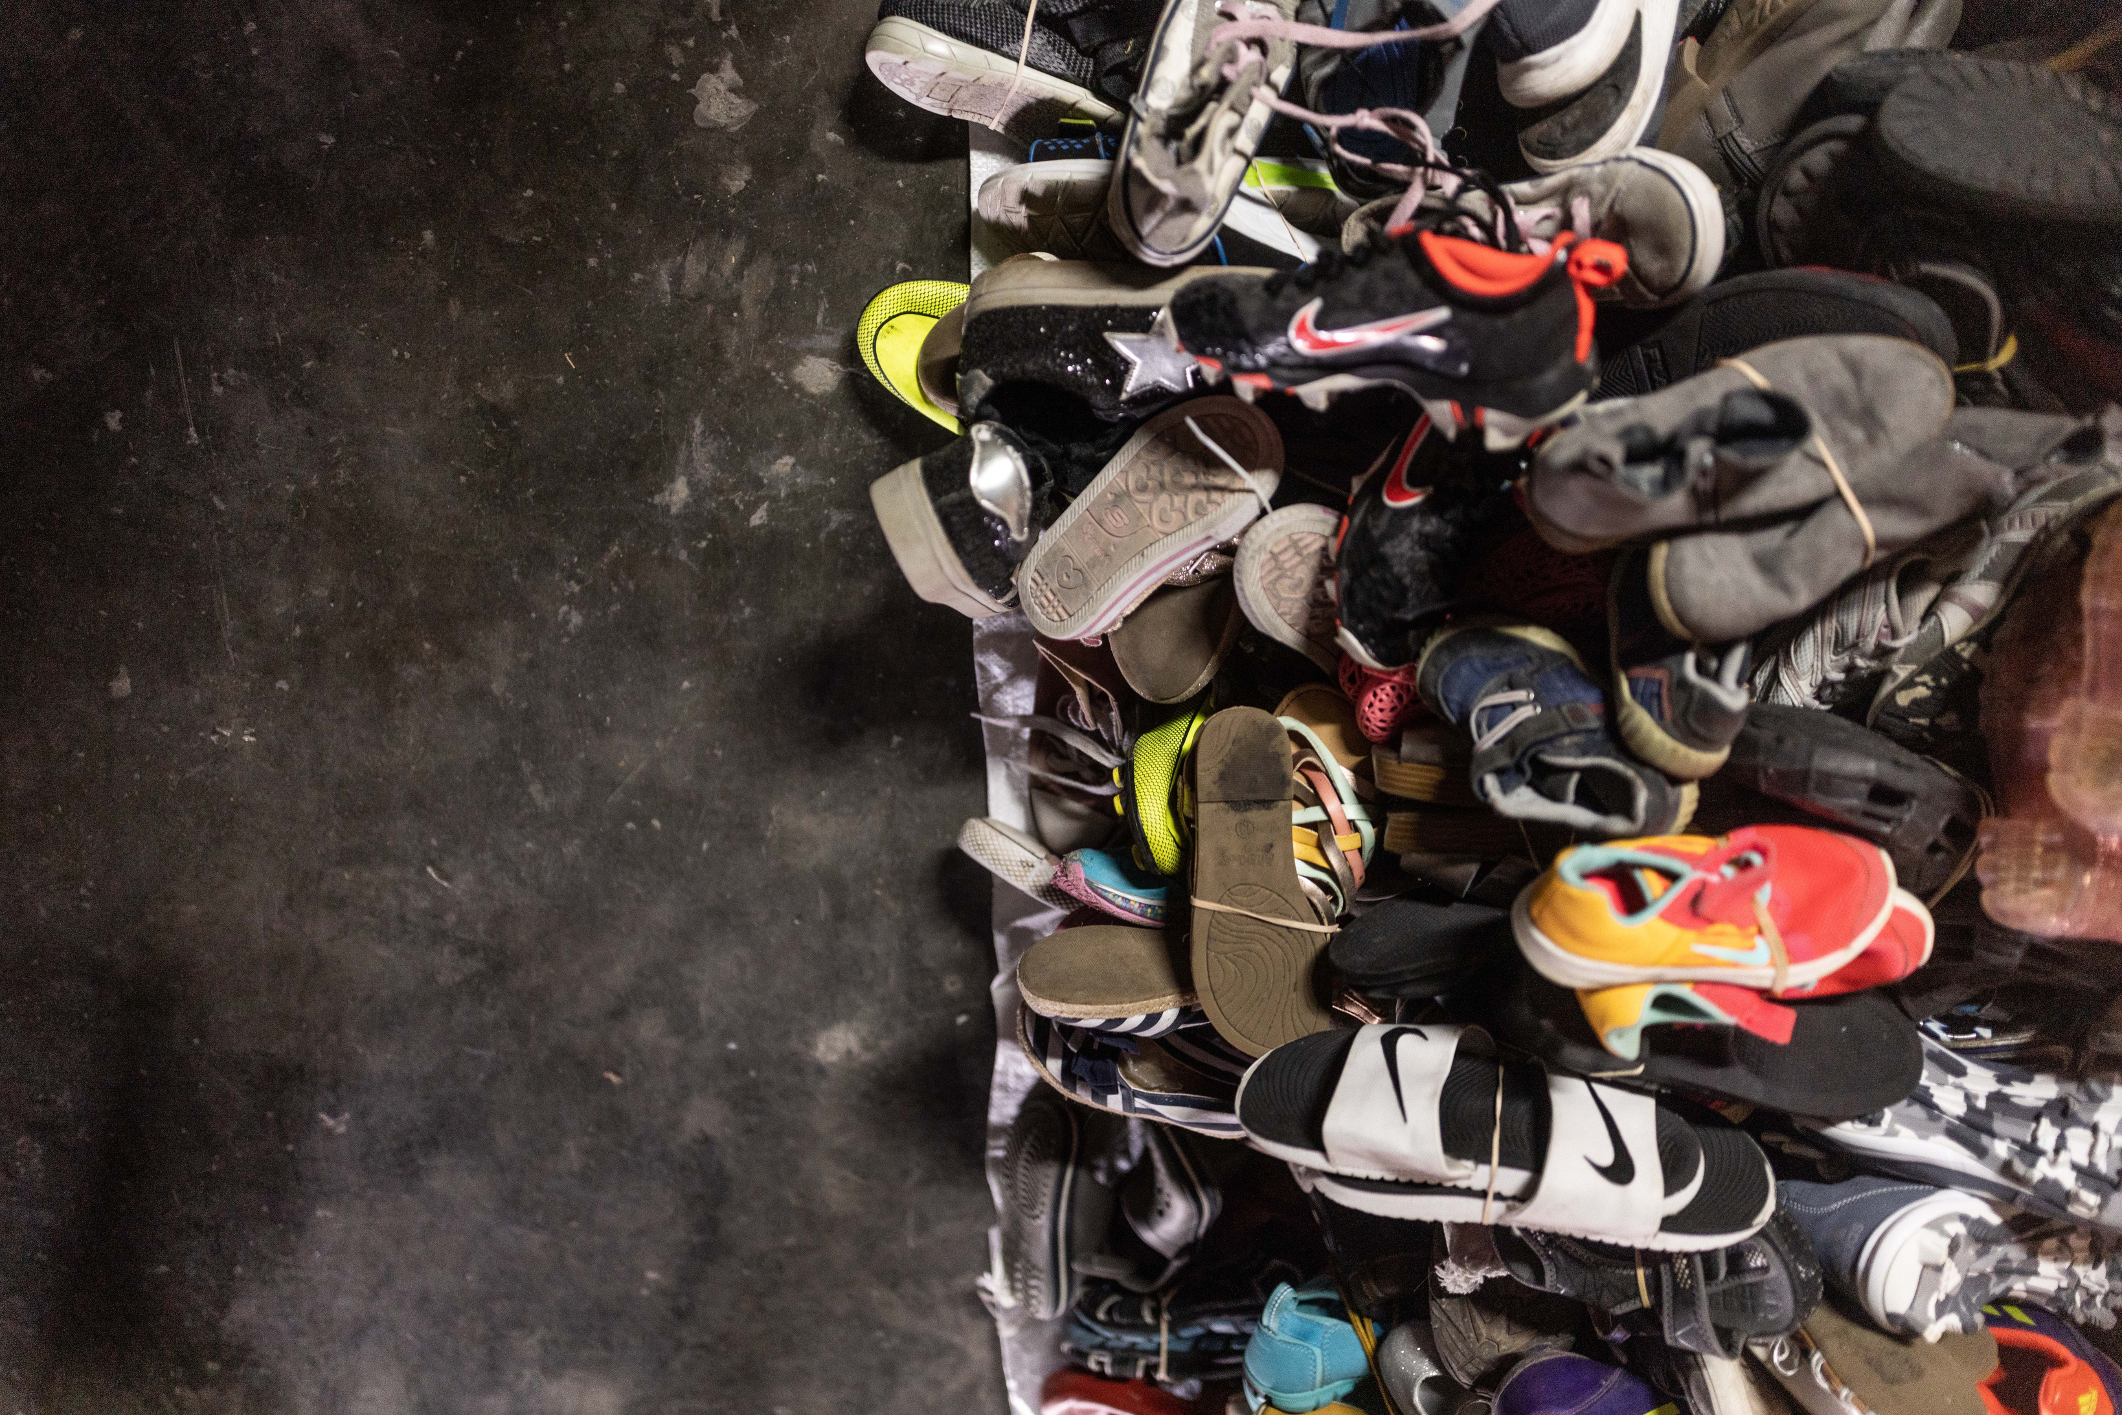
Be a change-maker!
Kids like you can help us do good things all over the world!
  Ask a grownup if you can donate shoes you don’t wear anymore.
  Ask your friends and neighbors to donate their extra shoes.

Slide 13
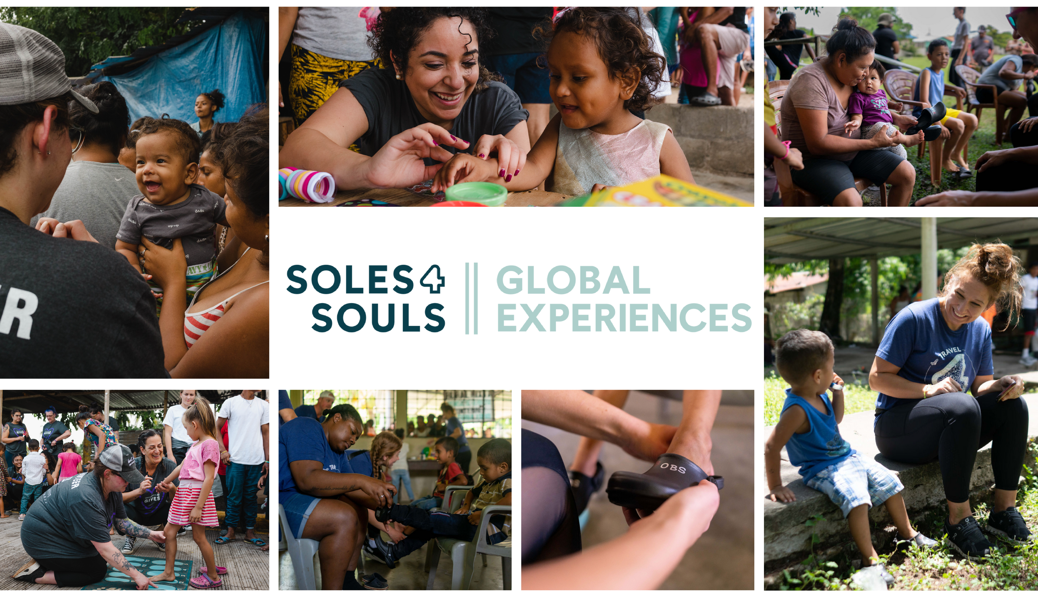

Slide 14
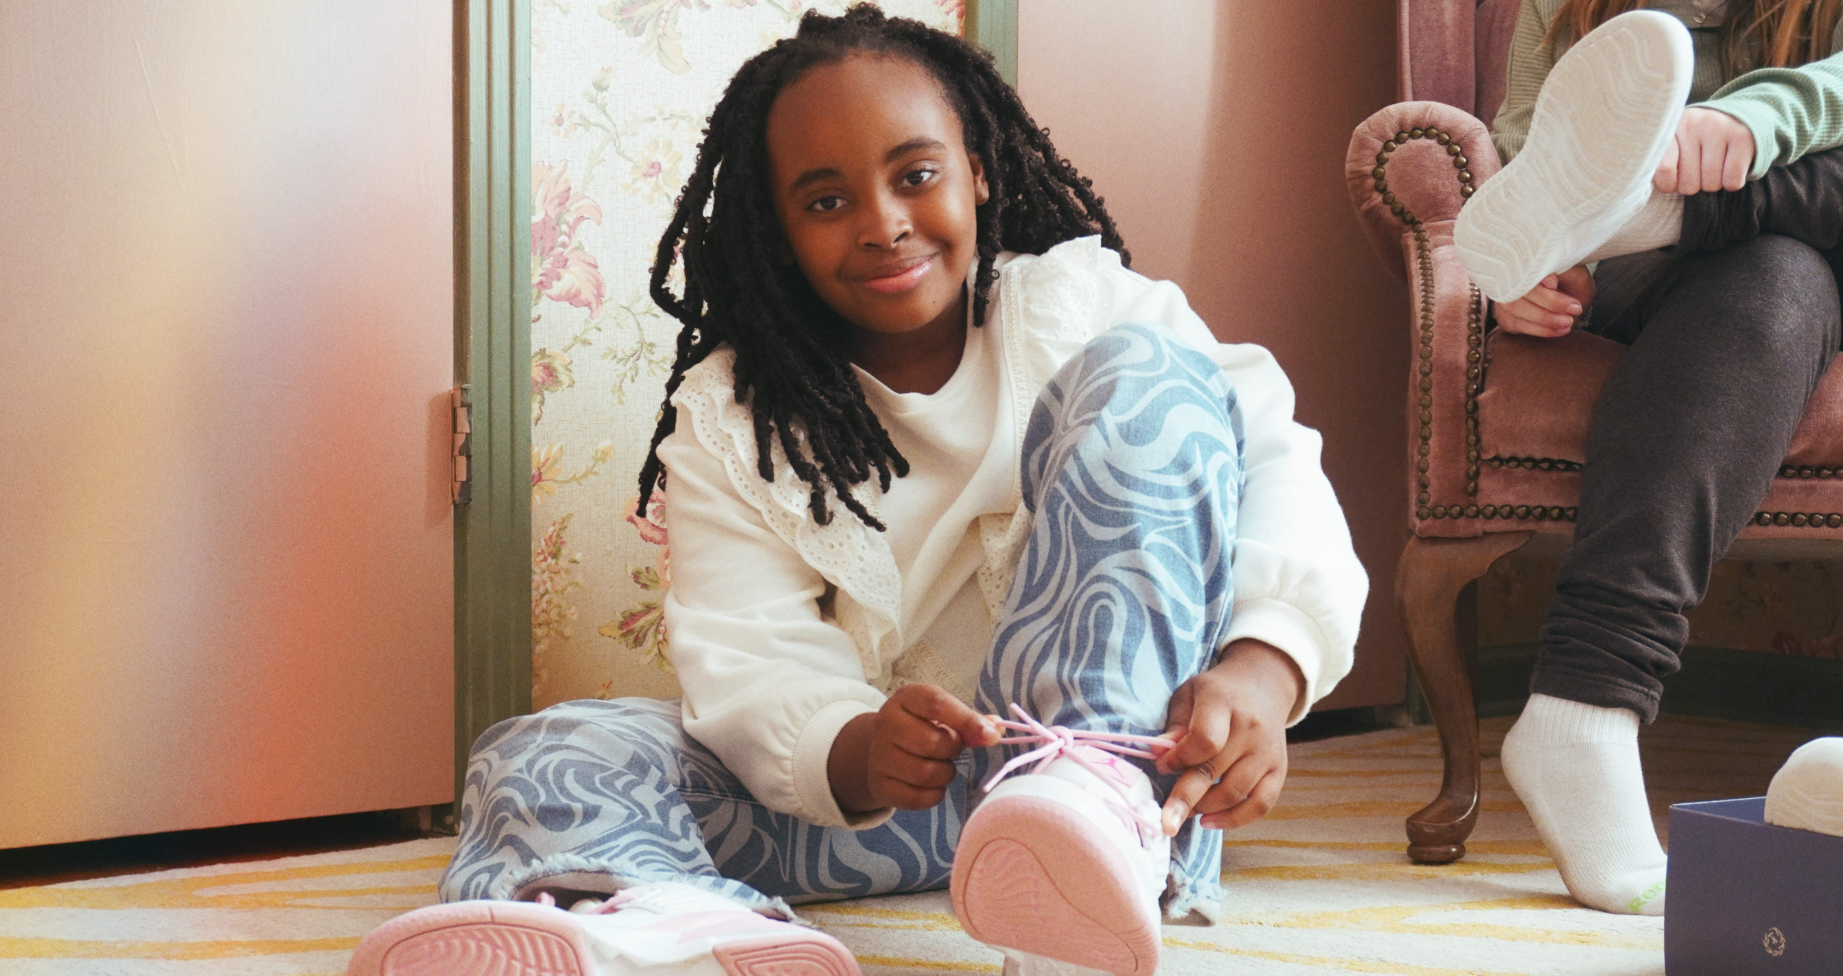
THANK YOU!
Visit us at s4s.org
Follow us @Soles4Souls

